Slide 1
C-MAC Crop monitoring & Advisory Companion
“Your go-to App For Crop Monitoring And Advisory”

Slide 2
Indian Farmers of cash crops such as oil palm, pulpwood lose ~15% of their income on an average due to not adhering to crop recommendations as per the growth cycle calendar

Slide 3
Reasons for non-adherence
No access to Crop Calendar and Best Practices
Most of the Farmers are traditional in nature with no know-how of how to access government and other resources related to crop calendar In addition, the best practices innovated by the Agri-Tech companies and Corporations are not reaching the Farmers and are not a part of their activities
Lack of knowledge of the Vital Few activities to boost Crop viability
The incremental impact of the adherence to irrigation, cultivation, nutrient dosage, etc. is not known to the Farmers. They either tend to do all of them or none of them. Instead, they are not knowing the 1-2 activities which give them maximum benefit

Slide 4
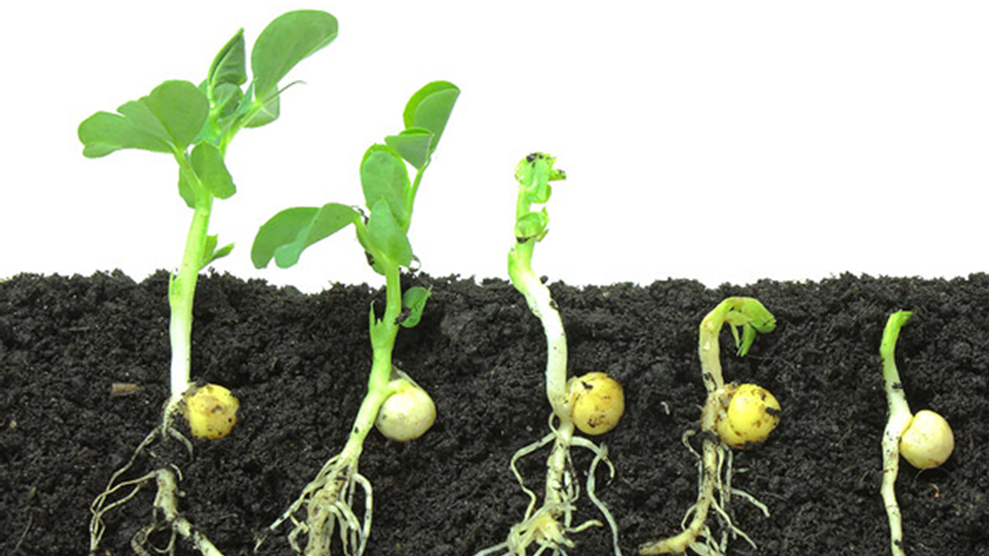
C-MAC
Crop Monitoring & Advisory Companion
A digital app to enable the Farmers to keep a track of their activities as per crop calendar, and provide customized, plot-level insights for their crop based on soil and weather data aggregated across the community/region for multiple seasons

Slide 5
Business Case
How do we ensure crop viability for Farmers of Cash Crops ?
How do we ensure long-term stability in demand-supply balance, price, and quality at harvest ?
Benefits
Improved productivity and crop economic viability (INR/acre/annum) – Higher earnings for Farmers
Improved visibility of crop availability and harvestable crop identification
Opportunity
Footprint of Digital
Enabling Data Collection across ~millions of Farmers
Direct Channel between Corporations and Farmers to get data and communicate back
Real-time data and improved visibility across the value chain

Slide 6
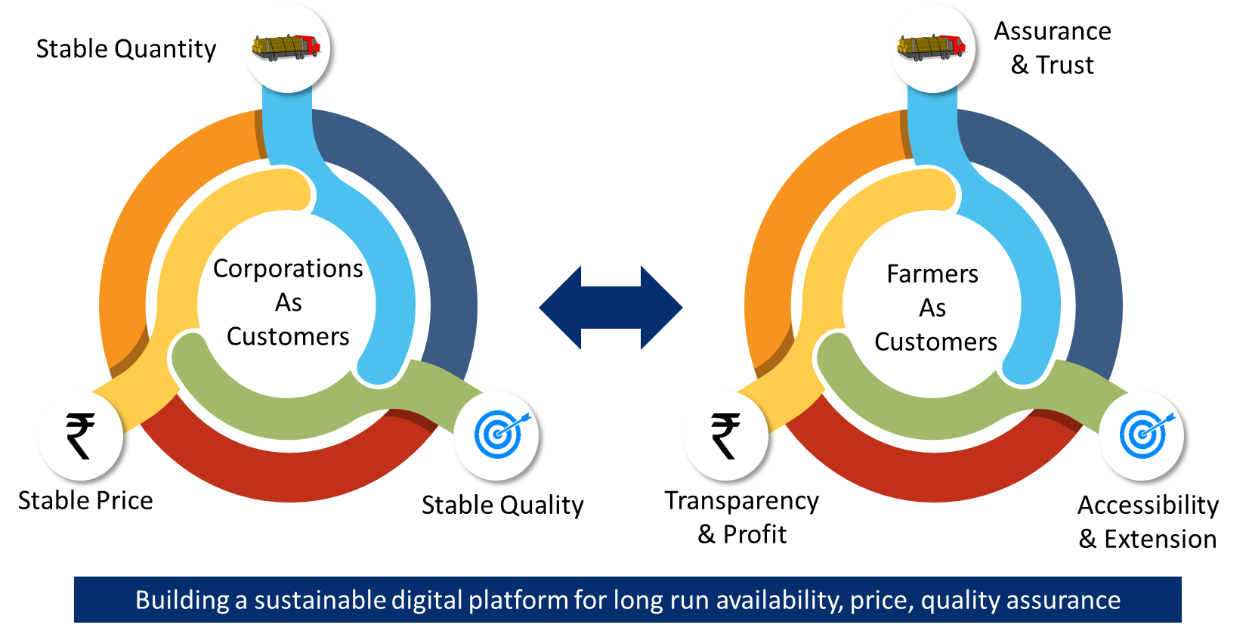
Goal & vision

Slide 7
Business Model Canvas
Key Partners
Farmers
Technology/Service suppliers
Research Institutes
Corporations/Buyers
Key Activities
Data acquisition
Data Analysis/Insights generation
Advisory Communication
Adherence tracking
Value Propositions
Increasing the economic viability of Farmers
Increase the crop security for Corporations/Buyers
Unified platform as a single point interface
Providing assurance to Farmers by being accessible and guiding them in monitoring & advisory activities throughout the lifecycle
Customer Relationships
Data analytics for customized plot-level insights
Farmers community develop to collect data for analysis
Customer Segments
Tech-savvy Farmers
Farmers with less time/less money to carry out all the recommended activities as per crop calendar
Absentee Farmers
Corporations with history of spending excess on crop procurement
Key Resources
Farmers
Field-Farm Labour
Machinery
Agri-Experts
Channels
Insert your content
Cost Structure
App development & Marketing
Cloud Server for Data Hosting; Analytics Engine
Revenue Streams
Subscription fee from Farmers and Corporations
Cross-selling opportunities for field-level agri-services

Slide 8
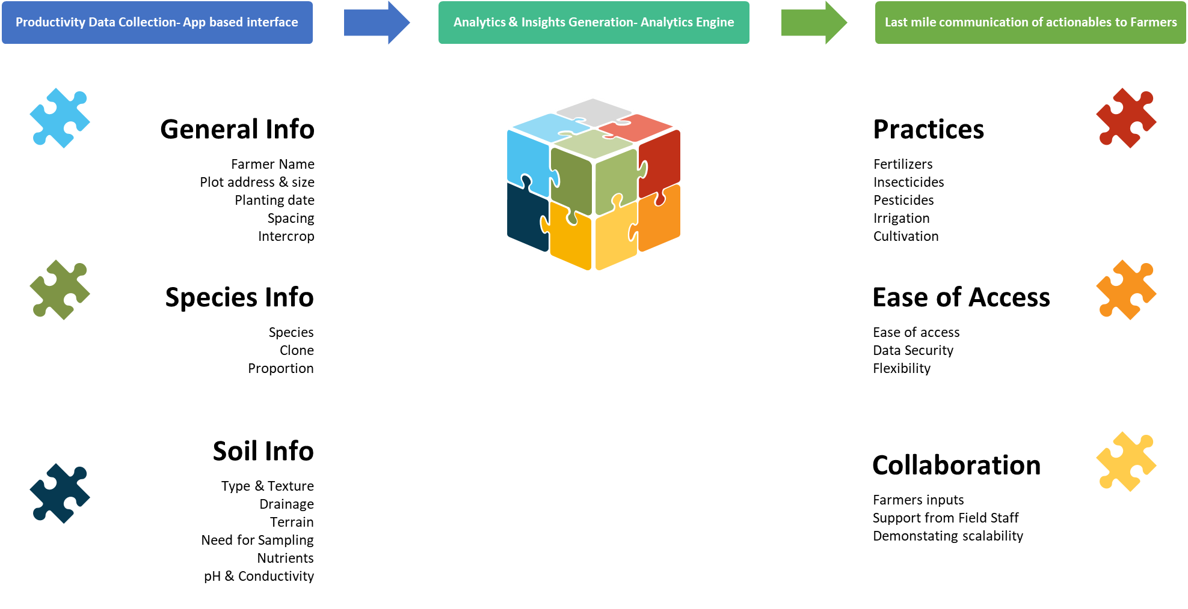
Key Features

Slide 9
Roadmap
Assessment of Uncertainties
Pilot Trials
And Insights Generation
Scrum planning and sprint release for scale up
1
3
5
2
4
6
MVP Building
Pilot Impact Tracking and Validating the Business Value Realization
Product release and User Utilization Monitoring

Slide 10
Release roadmap
Excel File

Slide 11

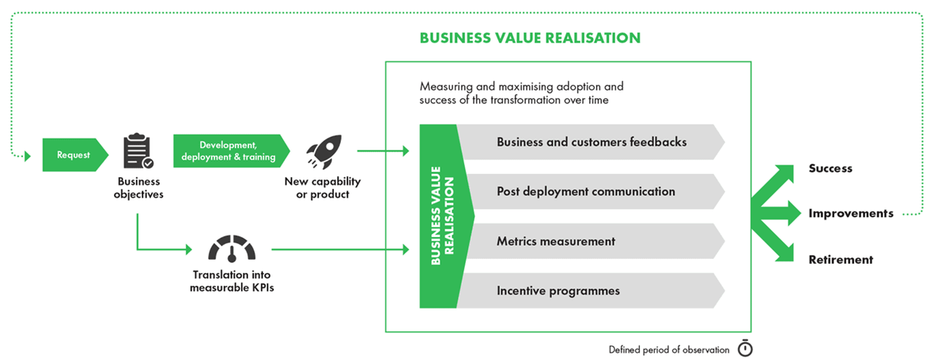
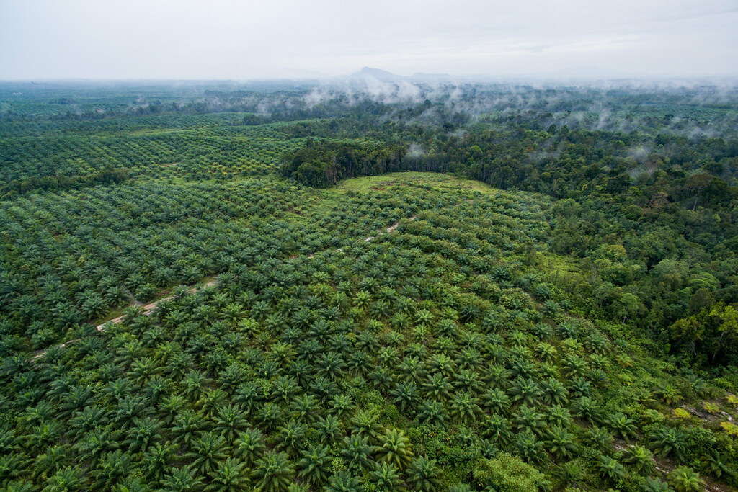
Business value realization

Slide 12
Thanks!
Any questions?
You can find me at:
srikar.turumella@gmail.com

